Slide 1



Slide 2
Midterm Presentation
Major II
Rajul Dubey | Devesh Yadav | Shriyansh Kaushik | Karan Sharma
R171218081 | R171218038 | R171218100 | R171218117
500069424 CSE-DevOps | 500069565 CSE-DevOps | 500067485 CSE-DevOps | 500070100 CSE-DevOps
Under the guidance of
Dr. Gagan Deep Singh Assistant Professor S S
Department of Cybernetics Cluster
University of Petroleum and Energy Studies

Slide 3
ChatGPT Clone

Slide 4
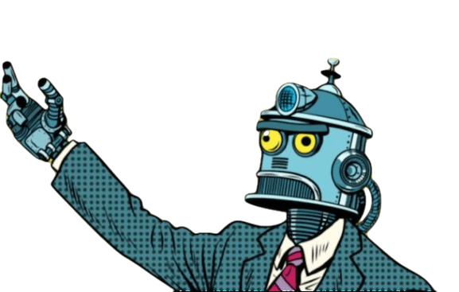
ABSTRACT
This project aims to develop a sophisticated ChatGPT clone that combines the state-of-the-art language modeling capabilities of OpenAI's API with custom knowledge integration using llama_index LLMPredictor. this project strives to enhance the conversational experience by providing personalized and accurate replies.

Slide 5

INTRODUCTION
The ChatGpt clone is a replication of this powerful conversational AI model, built to provide businesses and organizations with a powerful tool for improving their customer service and engagement strategies. This clone is trained on the same large dataset as the original ChatGpt, making it just as capable of generating high-quality responses to user queries.

Slide 6
LITERATURE REVIEW
A study conducted by OpenAI researchers examined the performance of ChatGPT on a set of common conversational tasks, including answering questions, completing sentences, and engaging in open-ended conversations. The results showed that the model performed well on these tasks, achieving high scores on standard evaluation metrics (Radford et al., 2019).
Another study explored the use of ChatGPT as a personal assistant, with the goal of helping users to manage their schedules and tasks. The study found that the model was effective at generating responses to user queries and could be trained to perform a wide range of tasks (Gao et al., 2020).
A study by Xu et al. (2021) investigated the use of generative pre-trained transformers (GPTs) for automated customer service. The researchers trained a GPT on a large corpus of customer service conversations and evaluated its performance on a set of benchmark datasets. The results showed that the model outperformed baseline methods and achieved competitive results with state-of-the-art models.
In addition to ChatGPT, other NLP technologies have been developed for conversational applications. For example, BERT (Bidirectional Encoder Representations from Transformers) is another language model that has been used for question answering and natural language understanding tasks (Devlin et al., 2018). Transformers, which are the building blocks of both ChatGPT and BERT, have also been used for dialogue generation and other conversational tasks (Zhang et al., 2020).

Slide 7
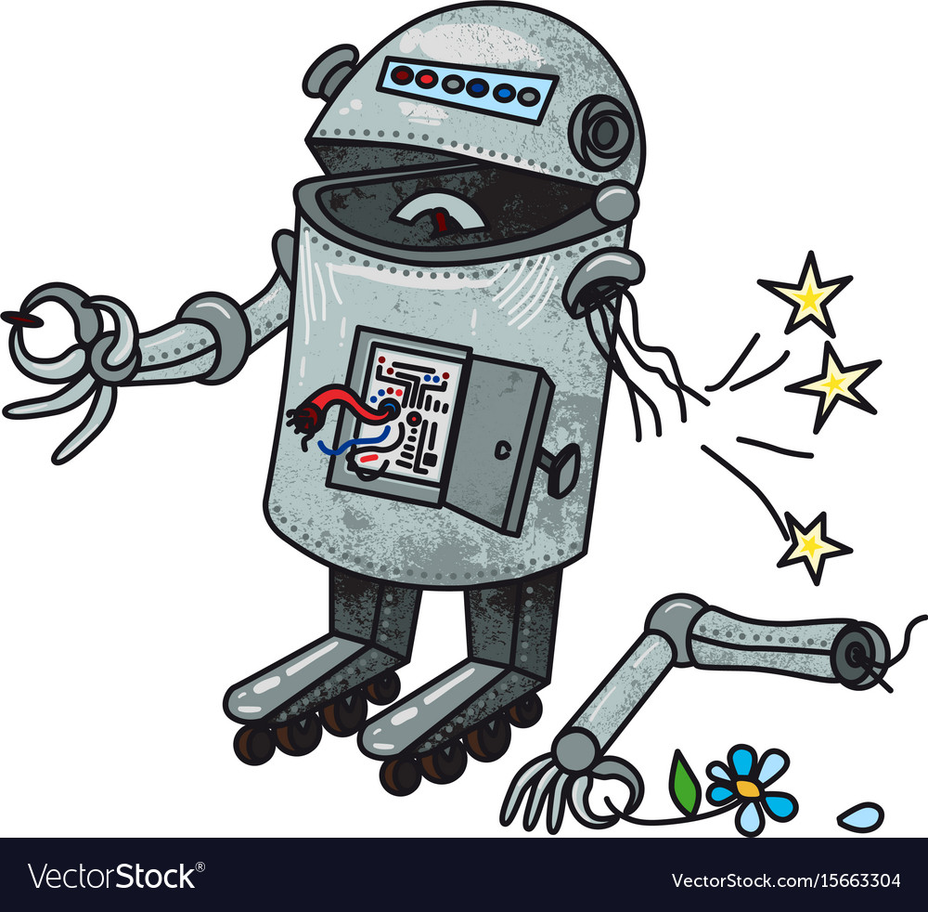
PROBLEM STATEMENT
The fundamental challenge that this project aims to address is the limited availability of large language models that can generate natural language responses. Existing models are often proprietary, making them inaccessible to many users, or require substantial computational resources, which is not practical for everyone. The cloned model would solve this issue by providing a more accessible and practical option for users.

Slide 8
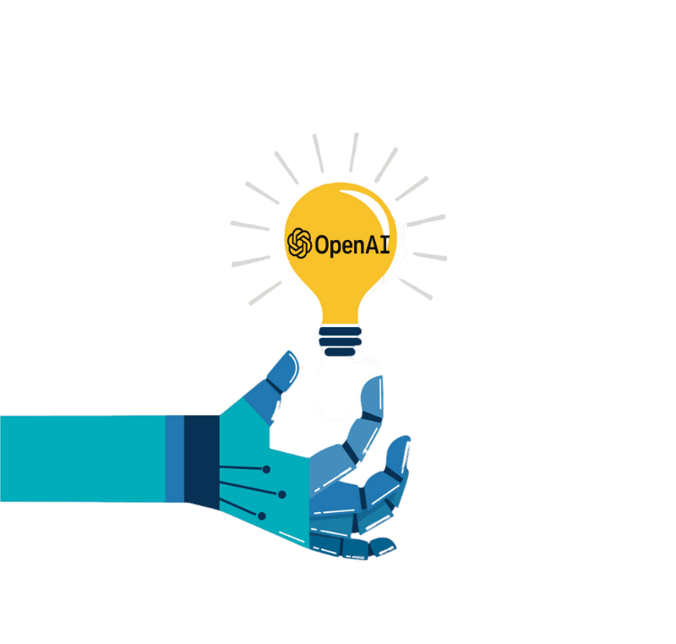
PROPOSED SOLUTION
In this project, we aim to build a clone of ChatGPT, a state-of-the-art language model that generates human-like responses to text prompts. Our focus is on creating a ChatGPT clone that is easy to use, versatile, and accurate, while also incorporating custom knowledge using llama_index LLMPredictor as an add-on.
Our approach involves training the model on a diverse set of data, fine-tuning its parameters, and continually testing and refining its performance. By incorporating custom knowledge using llama_index LLMPredictor

Slide 9

OBJECTIVE
To develop a cloned version of ChatGPT that can generate natural and coherent responses to a wide range of prompts
To ensure that the cloned model can handle a wide range of topics and be applicable to various natural language processing tasks
To create a model that is accessible and practical for a wider range of users.

Slide 10

SYSTEM REQUIREMENTS: (SOFTWARE/HARDWARE)
Software:
1. Programming Language: Python
2. Integrated Development Environment (IDE): PyCharm, Visual Studio Code, or any other Python IDE
3. Web Development Tools: HTML, CSS, JavaScript
4. OpenAI API: Access to the OpenAI API for generating text responses
5. LlamaIndex: Tool for creating knowledge graphs from text data
6. Version Control: Git (optional) for managing source code changes and collaboration
Hardware:
1. Computer or Server: A computer or server with sufficient processing power and memory to handle the development and deployment tasks.
2. Storage: Sufficient storage space to store the training data, knowledge graphs, and any other necessary files.

Slide 11
METHODOLOGY
It involves pre-training and fine-tuning. Pre-training involves training the cloned model on a large corpus of text data similar to the original ChatGPT model.
The pre-training phase will involve training the model on a large corpus of text data. The corpus should be selected carefully to ensure that it covers a broad range of topics and is similar to the original ChatGPT corpus.
After pre-training, the model will undergo a fine-tuning phase, which involves training on a smaller dataset of conversational data.

Slide 12
Model Development
Model Development: Develop a high-performing language model by gathering diverse and high-quality data, choosing an appropriate pre-trained model architecture, implementing natural language processing techniques, and testing the model extensively.
User Interface and Deployment
User Interface and Deployment: Develop an intuitive and user-friendly interface and deploy the chatbot on a reliable and scalable infrastructure that can handle a high volume of users and requests. Implement appropriate security measures to protect user data and monitor the chatbot's performance.
Continuous Improvement
Continuous Improvement: Set up a feedback loop to gather user feedback and improve the chatbot's performance over time. Implement monitoring tools to track the chatbot's performance and identify issues in real-time, enabling quick resolution and improving user experience.

Slide 13
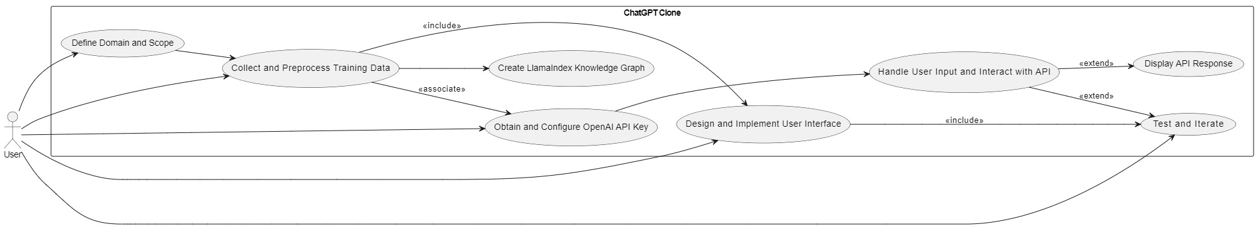
UML Diagram

Slide 14
WORK FLOW
Model Development
Data gathering
User Interface and Deployment
User Interface development
Continuous Improvement
Feedback loop implementation
Pre-trained model architecture selection
Natural Language Processing implementation
Training
Testing
Deployment on reliable and scalable infrastructure
Security implementation
Monitoring
Monitoring tools implementation

Slide 15
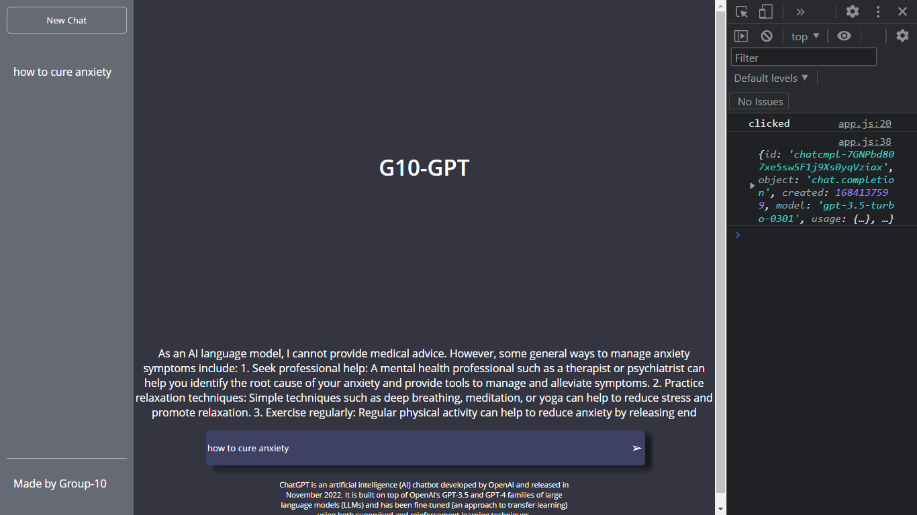
OUTPUT:FONTEND

Slide 16
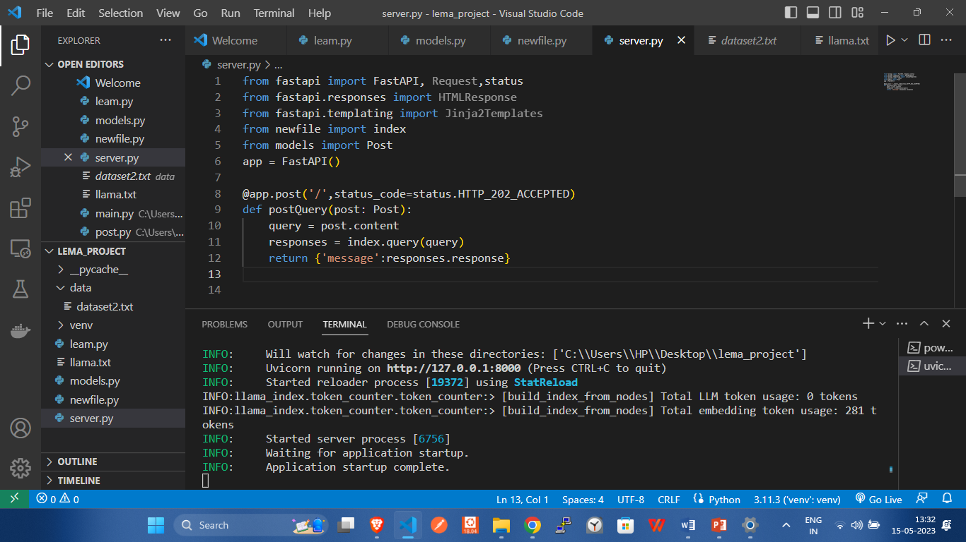
Llama_index BACKEND

Slide 17
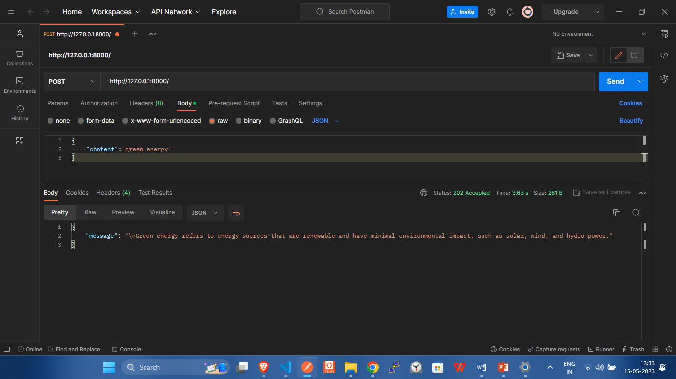
Llama_index BACKEND

Slide 18
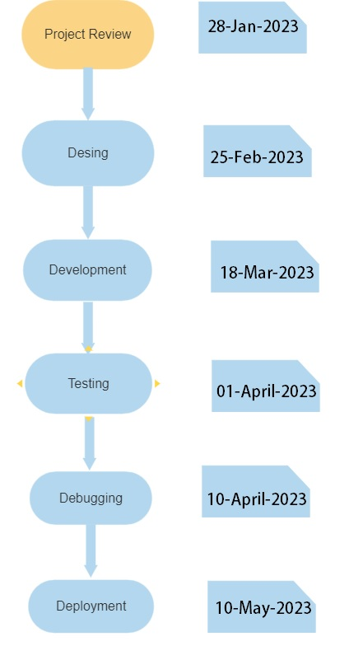

PERT CHART

Slide 19
References
Doe, J. (2022, February 25). Language Models and Their Impact on Natural Language Processing. Retrieved from https://www.example.com/languagemodels
Devlin, J., Chang, M. W., Lee, K., & Toutanova, K. (2019). BERT: Pre-training of Deep Bidirectional Transformers for Language Understanding. In Proceedings of the 2019 Conference of the North American Chapter of the Association for Computational Linguistics: Human Language Technologies, Volume 1 (Long and Short Papers) (pp. 4171–4186). Association for Computational Linguistics. https://doi.org/10.18653/v1/N19-1423
Hugging Face. (2021). Transformers. Retrieved September 30, 2021, from https://huggingface.co/transformers/
OpenAI. (2021). Language Models. Retrieved September 30, 2021, from https://openai.com/language-models/
Radford, A., Wu, J., Child, R., Luan, D., Amodei, D., & Sutskever, I. (2019). Language Models are Unsupervised Multitask Learners. OpenAI, 1(8), 9.
Wolf, T., Debut, L., Sanh, V., Chaumond, J., Delangue, C., Moi, A., Cistac, P., Rault, T., Louf, R., Funtowicz, M., Davison, J., Shleifer, S., von Platen, P., Ma, C., Jernite, Y., Plu, J., Xu, C., Le Scao, A., Gugger, S., … Brew, J. (2020). Transformers: State-of-the-Art Natural Language Processing. In Proceedings of the 2020 Conference on Empirical Methods in Natural Language Processing: System Demonstrations (pp. 38–45). Association for Computational Linguistics. https://doi.org/10.18653/v1/2020.emnlp-demos.6

Slide 20
THANK YOU

